Slide 1
Radix-4 SRT Divider Verification
Feng
Notes:
Radix-4: 2 digits of q each cycle
SRT: use lookup table to determine q

Slide 2
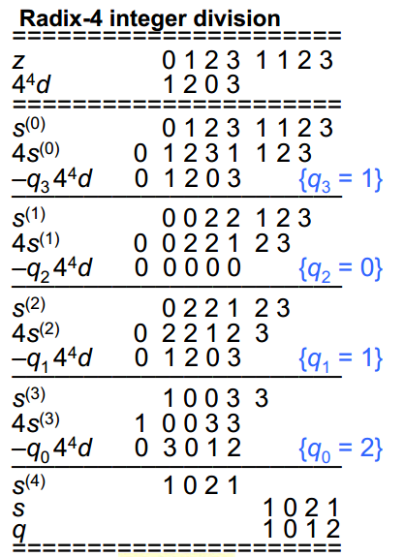
Steps of Division
Generate absolute value of divisor and dividend
Prescale dividend
Iteratively generate quotient digits
Shift remainder by 1 digit
Select 1 digit of q
Multiply q(i) with D
Subtract shifted q(i)*D from remainder, generate new remainder
Convert quotient to 2’s complement
Correct polarity of quotient and remainder

Slide 3
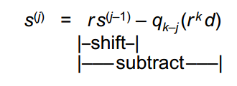
Example Block Diagram (32-bit signed division)
Divisor
Remainder
d[31:0]
s[31:0]
d[31:0]
d[30:27]
s[31:26]
Multiple Generation
Quotient Lookup Table
qk-j[2:0]
|qk-j|d
qk-j[2]
{s[29:0],2’b0}
{qk-jd}[31:0]
32-bit Adder
aout[31:0]
To Remainder
Notes:
Verification of SRT Divider with SRTEST is done by using specific dividend/divisor pair to hit corner cases of the quotient selection table

Slide 4
p
Quotient lookup table
011.000
8d/3
Assume
Digit set for q is [-2,2]
No carry save adder
ABS(Divisor) before dividing
010.000
q=2
5d/3
4d/3
q=1
001.000
2d/3
We need
4-bit of d
6-bit of p for lookup
1024-entry
1d/3
000.000
q=0
-1d/3
-2d/3
Corner cases
All corners on the region boundary
4 points that lies on overlap region boundary
(0.1001, 000.110)
(0.1001, 111.010)
(0.1100, 001.010)
(0.1100, 110.110)
111.000
q=-1
-4d/3
-5d/3
110.000
q=-2
-8d/3
101.000
d
0.1000
1.0000

Slide 5
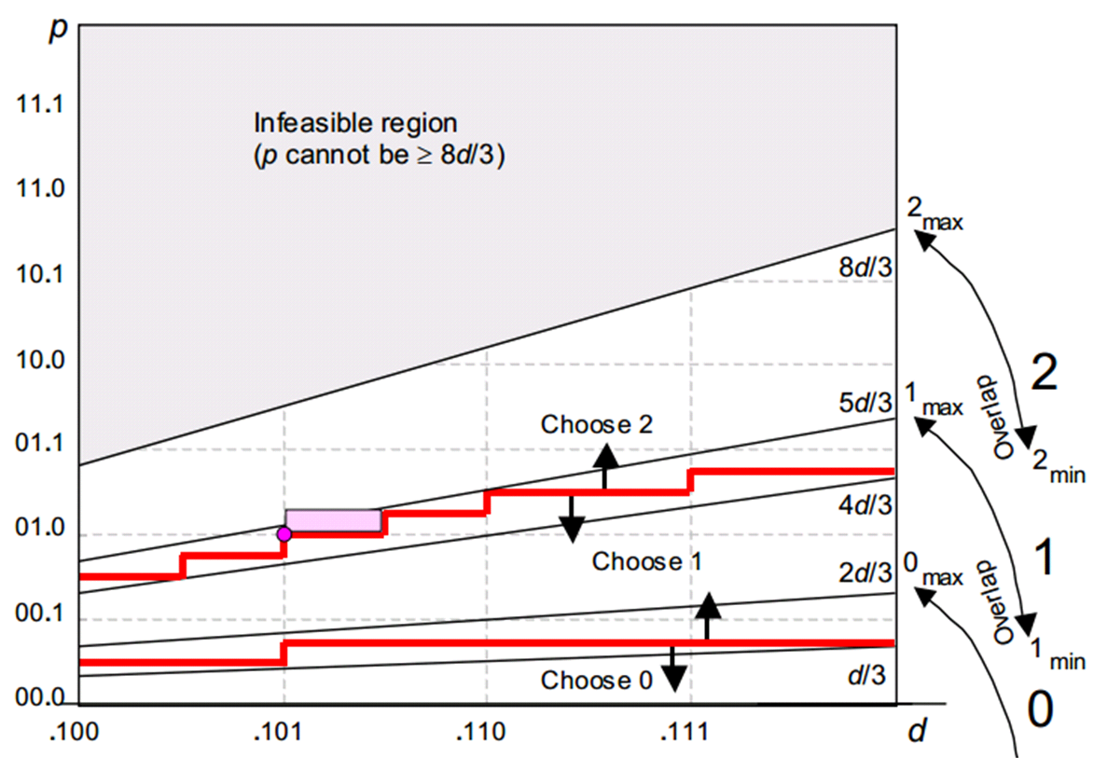
SRTEST
SRTEST systematically tests the
corner cases of the quotient
selection lookup table
SRTEST is based on two hypothesis
If a self-correction fails,
it fails near the vertical
strip
Partial remainder in
choose 0 region, but
actual value in
overlap region
Self-correction fails in region
shaped roughly like triangles

Slide 6
SRTEST Algorithm
SRTEST requires 3 arguments:
N = the number of leading bits of divisors that go to the lookup table
L = Log2( Radix ) ; i.e., Radix = 2^L .
M = maximum bit-width preassigned for divisors.
In our case, N=4, L=2, M=32
SRTEST uses (2*L + 1)*2^(N-1) divisors: (40 in our case)
Divisor = 2.0^M - j*2.0^(M-N) + S
where
j = 0, 1, 2, ..., 2^(N-1)
S={ -2^(L-1), ..., -4, -2, -1, 0, 1, 2, 4, ..., 2^(L-1) } .
Small offsets
Vertical strips
SRTEST dividend starts with odd integer 1,3,5,7…
The dividend will be scaled to 2^(M-1) ~ 2^M range and add a small offset 2^I
Where I is any small integer (0 works fine, L-1 works better)

Slide 7
Test Overflow at Nth quotient digit
Z = D*q(1)*r^(k-1) + D*q(2)*r^(k-2) + D*q(3)*r^(k-3)…
Nth remainder is
r(n)=D*q(n)*r^(k-n) + D*q(n+1)*r^(k-n-1) + D*q(n+2)*r^(k-n-2)…
If we want the Nth remainder to lie near the singularities
q(i) = [-2,2] for i<n
q(n) = {-2,-1,1,2}
q(j) = 0 for j>n
randomly select a q(j) as 1 or -1 to test near singularity points

Slide 8
11000
10000
q=2
01000
q=1
q=0
00000
1100
10000
1000

Slide 9

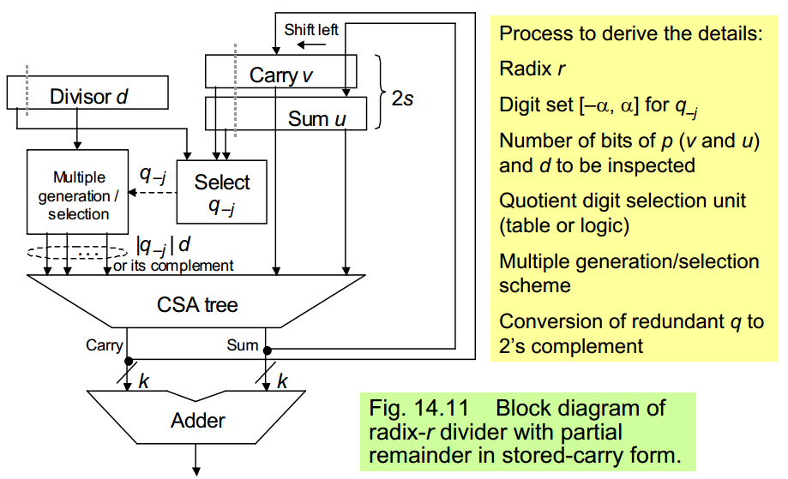
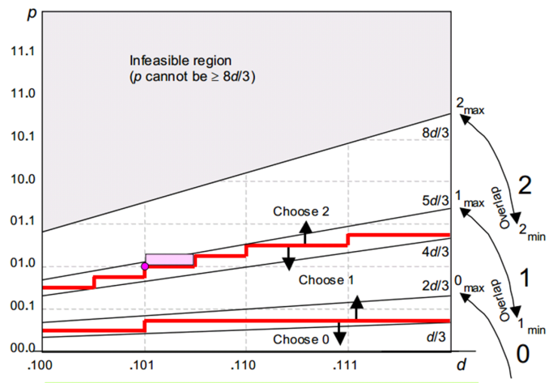

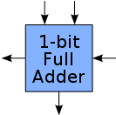
Block Diagram
(r=4)
rs
P
q(n)
v(n)
carry(n)
u(n)
sum(n)

